Slide 1

Hospital Management System
Bhavesh Khanchandani
© All rights reserved by Fireblaze Technologies Pvt. Ltd.

Slide 2
Problem Statement
Create a Hospital Management System which has Multiple tables and relationships between the tables depending on the constraints which we are passing to connect the different tables. By using this database we will retrieve the information of particular Patients, and Doctors who are working in the Hospital.
The Hospital wants to build a database for management of all the data with all the details like medical history and diagnosis, appointments, etc.
You have to build the database from scratch. Organizations such as hospitals have to deal with a lot of patients regularly and hence a lot of data. Therefore it is very important for a hospital to have a DBMS that allows doctors or administrators to manage patient data.
© All rights reserved by Fireblaze Technologies Pvt. Ltd.

Slide 3
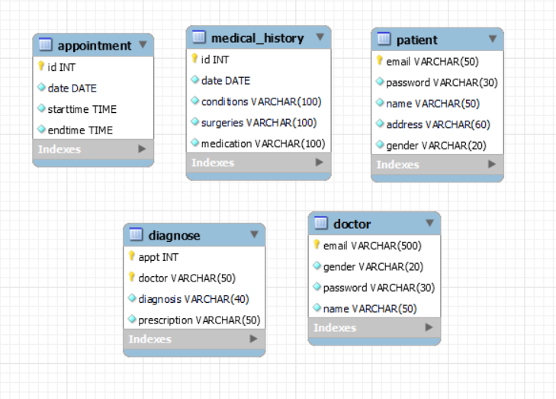
About the Data
Tables in the Data
Patient
Medical_history
Doctor
Appointment
Diagnose
© All rights reserved by Fireblaze Technologies Pvt. Ltd.

Slide 4
Proposed Solution
There are Five tables in the database which we have to create in our schema
Step 1 Create a Database Hospital_db.
Step 2 Create all Table Structure. Using Create Table Command
Step 3 Insert Data In The Table. Using INSERT INTO command
Step 4 Solve all the Data Retrieving Problems given in the questions
Step 5 Insert a Column id into Patient table
© All rights reserved by Fireblaze Technologies Pvt. Ltd.

Slide 5
Conclusion
Healthcare databases assist with diagnosis and treatment, manage documentation and billing, and help reduce errors in medical operations and management. Because they limit paperwork and staff, databases in healthcare reduce medical facility running costs while improving performance.
All the patients have unique addresses
More male doctors than female doctors
Many patients do not require surgeries
© All rights reserved by Fireblaze Technologies Pvt. Ltd.

Slide 6
Future Scope
We can create more tables and connect them with one another as per the requirements of the hospital, we can also design a web-page in order to integrate our database with it
© All rights reserved by Fireblaze Technologies Pvt. Ltd.

